Slide 1
North American Oil – How Does The US Continue To Affect Global Balances?
Copyright © 2016 by S&P Global.
All rights reserved.
Platts Analytics
September 2016

Slide 2
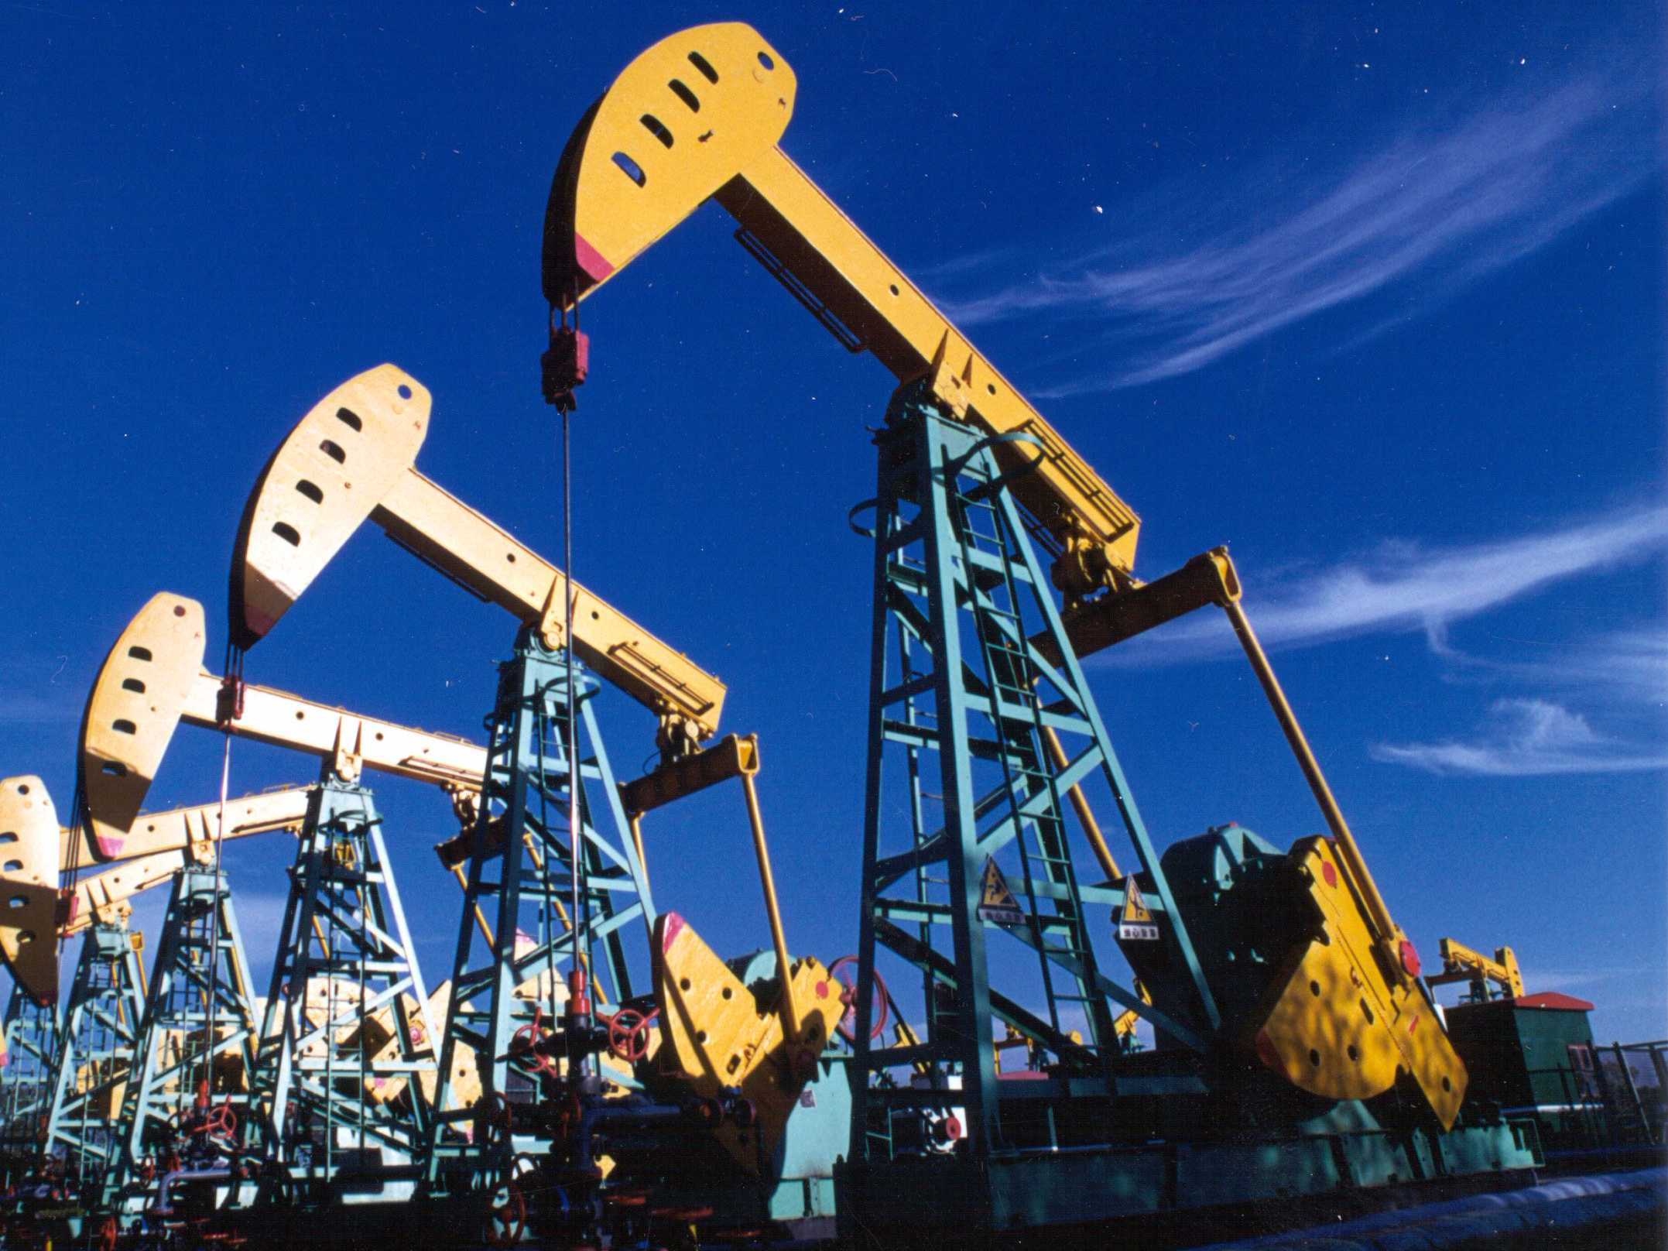
Talking Points
US oil production expected to resume growth near term as economics of DUCs may look attractive in current price environment.
However – supply overhang is not resolved as reflected in refining and cracking margins. The supply glut continues to push downstream.
The US is an energy story – not just a crude story.
The naphtha/LPG competition that has been instigated by US LPG production continues.
Expected price recovery is dependent upon consistent global demand growth. In the near term, the US may provide the marginal barrel at prices lower than many would like to see.

Slide 3
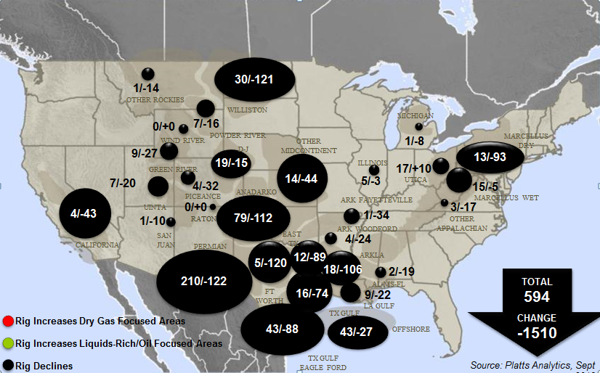
US Rig Count Off Lows – How Quickly Can Production Grow
US Rig Count Peaked At 2104 in October 2014

Slide 4
Inverse Relationship Between Price & Production Is A Global Story
US Production growth: +2.1 MMb/d
Jan 14-Nov 15
Total Production growth: +5.7 MMb/d
Jan 14-Nov 15

Slide 5
As Prices Tested Fundamental Floor – Production Slowed – But Was It Enough?
Notes:
From a fundamental stand point, prices should do their job here and force NA production to roll over. Very few producers actually recognize WTI pricing at the wellhead.

Slide 6
DUC Inventory Beginning To Draw Down In Texas
Continues To Build In North Dakota (As of July 15 ND Reports Increasing Production)
Notes:
Horizontal oil and gas wells only

Slide 7
Half-cycle Wellhead Oil Breakevens Say Its Time To Drill – Quarter Cycle Is Even Better
1/4 Cycle IRRs

Slide 8
As Net Capital Inflows Continue to Support Producers
$30 BILLION Dollars In Q1 - Q2 Reduces Debt

Slide 9
Current Activity Holds Production Flat – 30 % Increase In Well Activity And Partial Completion OF DUCs Adds .8 MMB/d By December 2017
9.6 MMB/d Dec 18
9.6 MMB/d April 15
9.4 MMB/d Dec 17
8.6 MMB/d Sep 16
Notes:
Complete all of Permian and half of ND

Slide 10
Is The Market Finally Balanced? Averages Say “Close” - Answer Is “Probably Not”

Slide 11
Perpetual Downstream Over Supply Pulls On Margins – Current Prices Favors Brent at USGC
2014
Average $8.64
2015
Average $9.35
YTD $3.35
vs $11.55 YTD 2015
Notes:
Crude is NOT the problem!!! Lack of downstream demand for what crude makes is the problem!!! Refining margins struggle as refined product prices contine to fall faster than crude (feedstock ) prices. This is reflective of oversupplied global refined product markets.

Slide 12
Net Exports of Refined Products Flat To Slightly Higher - But To What Effect?
2016 YTD 1.7 MMB/d
Vs
2015 YTD 1.5 MMB/d
2014 1.65 MMB/d
Vs
2015 1.72 MMb/d
Notes:
YTD exports of refined products are higher but it is not helping margins. We are pushing refined barrels into the global market at lower prices in an attempt to keep/take market share..
Export 2015 was 3.7 2016 3.9
Import 2015 2.1 2016 2.0

Slide 13
Refined Product Exports Flood Markets As Storage Remains At Record Levels – NOTHING HAS CHANGED
Current Inventories
45 MM Above Last Year
110 MM Above 5 Year Average
Source: EIA (includes gasoline, distillate, jet fuel, fuel oil, propane, ethanol and other

Slide 14
Selling Prices Of Barrels Converge As Any Market Will Do
US Loses Least Coast Feedstock Advantage
Arab barrels price themselves into global markets
US WAS enjoying lowest feedstock price
Notes:
Russia's export duty on its main Urals crude and other crude blends --
except those enjoying a more favorable tax regime -- will be set at $73.30/mt
($10/b calculated at 7.33 barrels/mt) for January, down 17% from $88.40/mt
($12.06/b) for December.
The export duty is set according to a formula and the change reflects a
decrease in the average Urals price on the international market during the
monitoring period.
For January the crude export duty is derived from an average Urals price
of $39.40/b over November 15-December 14, according to finance ministry data
obtained by Platts Tuesday.
The average Urals price over October 15-November 14, the monitoring
period for December, was $44.33/b.

Slide 15
As Selling Prices Shift Refined Margins Converge –
USGC Loses Advantage
Global Playing Field For Refined Products Is Flat
Asia Advantaged
Asia Disadvantaged
Convergence - Who Is At Highest Risk?
Notes:
Unlike 2015, gasoline is now holding up European margins, not diesel. If gasoline demand slows Europe will break

Slide 16
Coking Margins – US Holds 2/3 Of Global Coking Capacity
Complexity of US Refiners Offers Additional Uplift To Cracks

Slide 17
US Crude Blend Yields Makes Light & Heavy Naphtha
We All Make The Same Things
Weighted Average US Barrel Yields 30% Naphtha & 3% LPG
12 MMbd US & Canadian Production X 30% Yields
4 MMBd of Naphtha
Notes:
US crude is light which means it creates naphtha – naphtha is the preferred feedstock for global petchem crackers. However, we have introduced so much naptha intot the global markets that out petchem markets are choking on what we create.

Slide 18
Its Not All About Crude - U.S. Liquids and Gas Combined Output Expected to Increase by an Additional 2.8 MMBoe/d by 2021
2.8 MMBoe/d
2015 vs 2021
8.2 MMBoe/d
2010 vs 2015
-.7 MMboe/d
Source: Platts Analytics / BENTEK NG Market Call Long Term, NGL Market Call, and Crude Oil Market Call
Notes:
The US is NOT a Crude story, it is an ENERGY story. At the right price BTUs are interchagable.

Slide 19
Is US LPG The Marginal BTU?
In Less Than 4 Years, Exceed Previous Top Four Exporters Combined
Record high: 1.1 MMb/d
2014 Avg: 497 Mb/d
2012 Avg: 197 Mb/d

Slide 20
Price Uplift Dependent Upon Annual Global Demand Growth Of ~700 MB/d – Is That Feasible Given The Competition?

Slide 21
Thank You
Suzanne Minter
Director - Strategic Industry Analysis
sminter@spglobal.com

