Slide 1
Global Gas Trends
18 April 2017
Michael Stoppard, Chief Strategist Global Gas
Michael.Stoppard@ihsmarkit.com

Slide 2
Five Key Points
Global gas demand to grow strongly, but regionally differentiated
LNG will meet a large share of growth in importing countries to 2020
Europe will be the balancing point for global gas
Competition between Russian pipe and global LNG set to increase
US LNG setting a new cost benchmark

Slide 3
1. Global gas set to grow strongly but regionally differentiated US and China driving increased gas penetration; Europe unclear

Slide 4
2. LNG will meet a large share of gas demand growth in importing countries to 2020
CIS
Middle
East
North
America
Self-sufficient
Africa
Europe
Latin America
Importing countries
Other
Asia
Southeast
Asia
LNG supply capacity
India
China
JKT
Source: IHS. Notes: CIS = Commonwealth of Independent States, JKT = Japan, Korea, Taiwan.

Slide 5
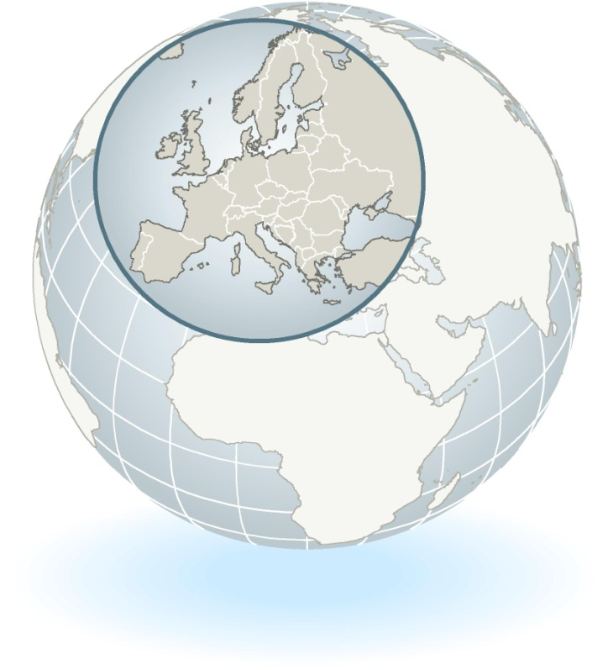
3. Europe will be the balancing point for global gas supply and demand
Europe’s unique balancing role
Large gas market
~500 Bcm
Underutilised
regas capacity
Liquid traded
markets
Purchase contracts
with significant
volume flexibility
Third party access
to gas infrastructure
Price responsive
demand
© 2017 IHS

Slide 6
4. Competition between Russian and global LNG set to increase

Slide 7
5. US LNG setting a new cost benchmark
Indicative costs of US LNG ($ per MMBtu)
Indicative LNG costs from North America
Henry Hub+
Liquefaction
Shipping
Regas
$3.50–5.00/MMBtu
$2.00–3.50/MMBtu
$1.00–1.50/MMBtu
$0.50–1.00/MMBtu
Total:
$7–11 per MMBtu
+4
Henry Hub
+4
Source: IHS
© 2016 IHS. All rights reserved. Provided “as is”, without any warranty. This map is not to be reproduced or disseminated and is not to be used nor cited as evidence in connection with any territorial claim. IHS is impartial and not an authority on international boundaries which might be subject to unresolved claims by multiple jurisdictions.
© 2016 IHS: 60807-1A

