Slide 1
Aftershock – Oil Markets After The Price Fall
Joel Hanley
Editorial Director, Oil

Slide 2
Aftershock – Oil Markets After The Price Fall
Causes and effects of the 2014/15 crude price crash
New crude trade trends
Impact on European refiners

Slide 3
Dated Brent back below $50/barrel
OPEC decision not to cut output
Source: Platts Data

Slide 4
Yearly averages
111.64
108.66
98.95
94.15
95.05
92.91
55.91
51.27
Year to date
Source: NYMEX, Platts

Slide 5
Impact on companies
CNOOC closing its oil trading division - Nexen Energy
Shell cuts capital investments by $15bn
Chevron to trim spending by 13%
Exxon Mobil to reduce CAPEX by 12% in 2015
Schlumberger to lay off 20,000 employees
Baker Hughes to reduce headcount by 7,000
Noble Energy cut its capital expenditure plans by 40%
Industry consolidation: Shell offers $70bn to acquire BG
But: Vitol’s annual profits rebound to $1.35bn – highest since 2011 – as volatility returns
Source: Financial Times, Platts, Bloomberg, Reuters

Slide 6
Market structure signals surplus
BACKWARDATION
CONTANGO
Source: ICE , NYMEX

Slide 7
The Big Three

Slide 8
Global oil supply balance – OPEC/non-OPEC
Source: EIA

Slide 9
US rig count vs. oil production
Source: Bloomberg, EIA, Baker Hughes

Slide 10
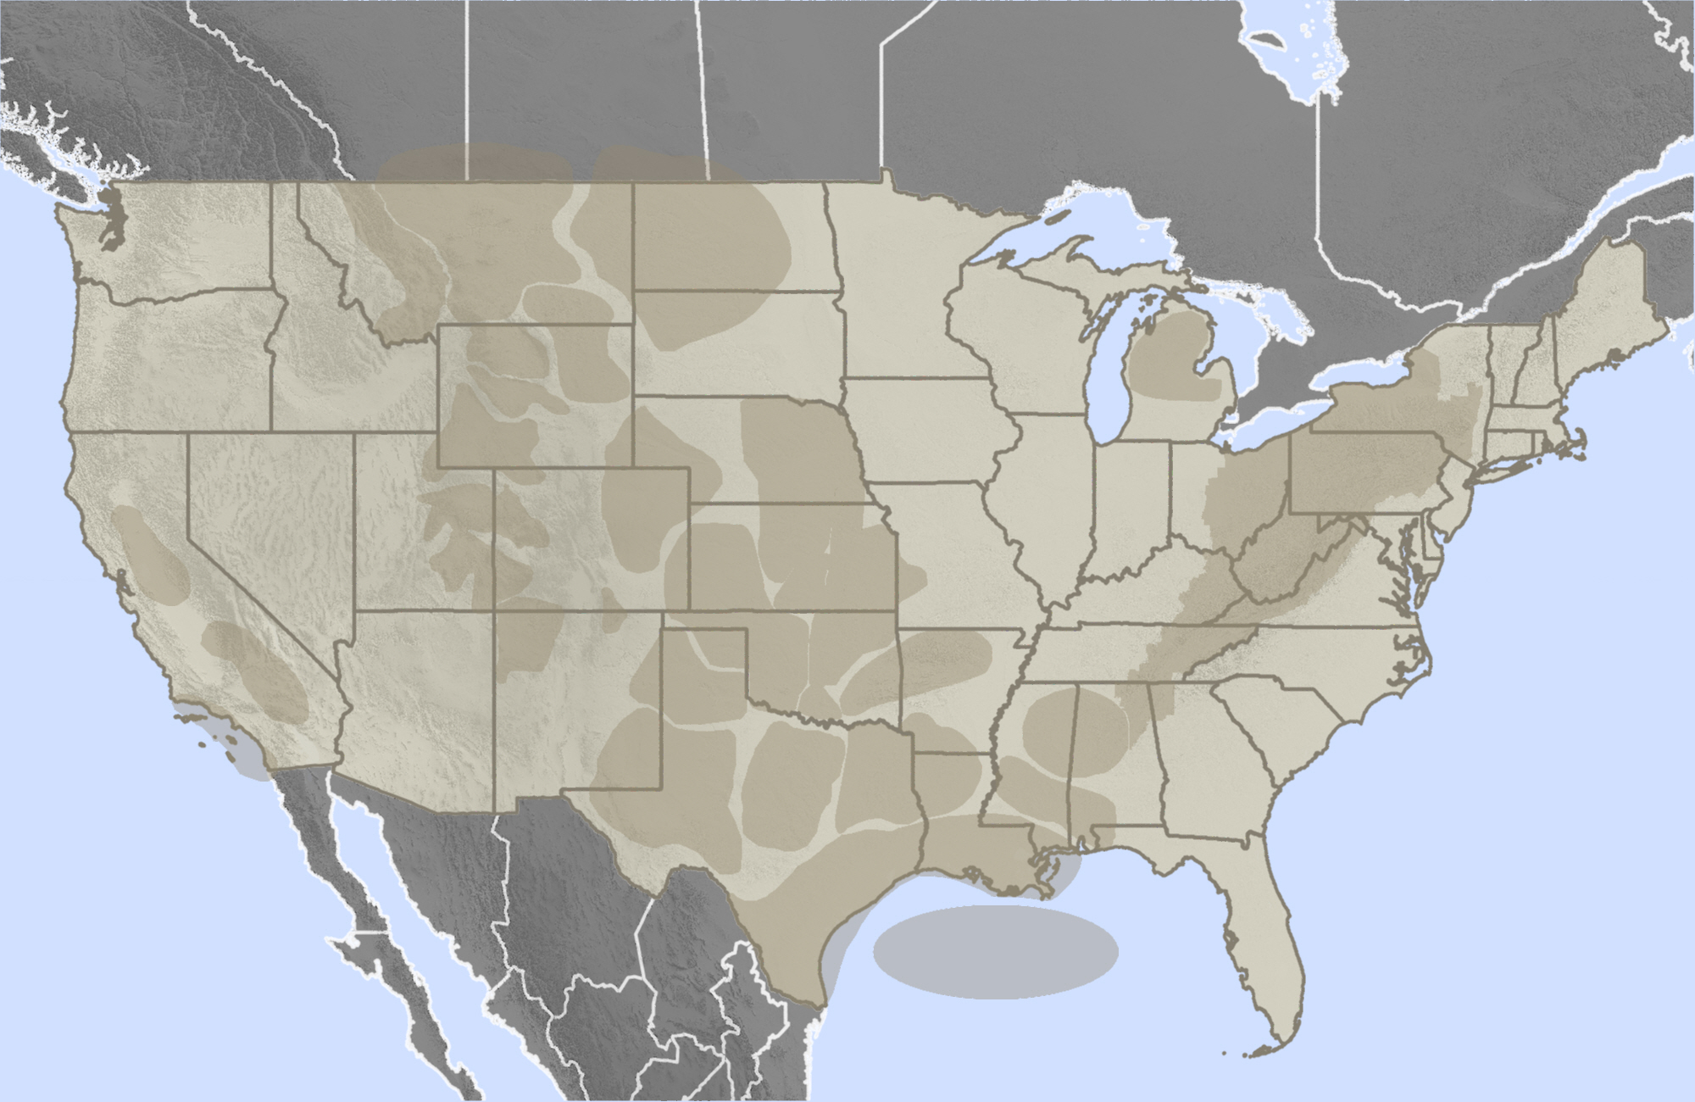
US producers’ breakeven prices around $40
$38
Bakken
Niobrara
22%/
69%
Uinta
$38
$49
Cleve/Tonk
Utica
$39
$29
Marcellus
$40/$45
Miss Lime
$43
Granite Wash
154%
$57
$55
Permian
Delaware
$41
Cana-Wood
Oil and/or Liquids Play
$40/
$47
$40/
$47
Eagle Ford
Oil/Wet
63%
Apr 2015 Price Assumptions: Gas = 12 month forward average curve for each regional pricing point (range $1.92 - $2.91/Mcf)
Oil = 12 month forward average WTI +/- differential (range $38.82-$54.24/barrel)
NGLs = weighted average $/barrel, 12-mo forward average Mt. Belvieu prices (range $19.25-$26.36/barrel)
Source: Bentek

Slide 11
US oil exports rising
Source: EIA

Slide 12
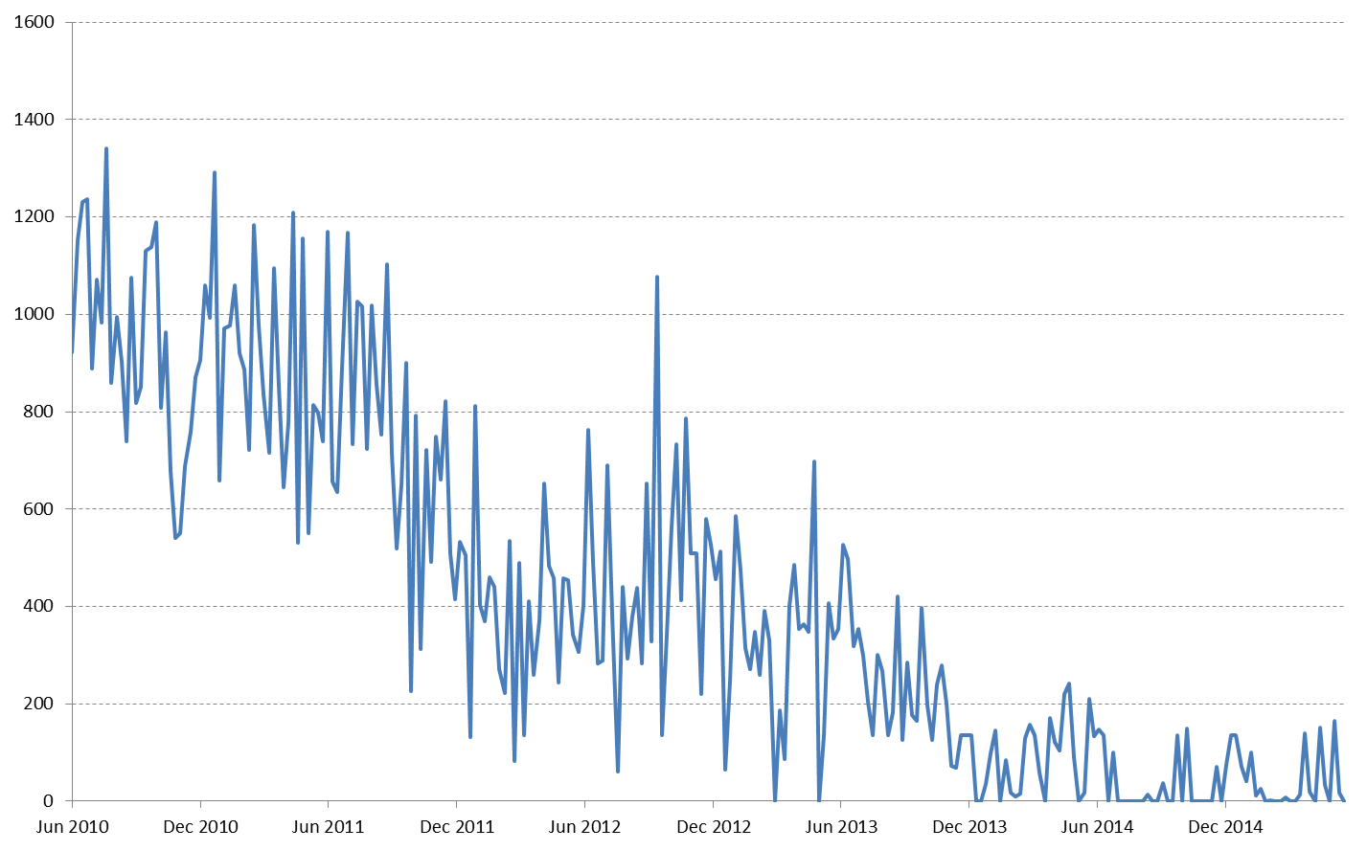
Tight Oil Pushes Nigeria out of US
Thousand b/d
No Nigerian crude sold
into the US all month
Source: EIA

Slide 13
Swelling Inventories
Mid-2015 Inventories
86 MMB Above Last Year
102 MMB Above 5 Year Average
Source: EIA

Slide 14
European Refining Margins Soar
Source: Platts Data, Turner Mason

Slide 15
US gasoline consumption
Source: EIA

Slide 16
Budget impact ($/b)
157
Yemen
Libya
125
119
107
Algeria
Iran
Russia
100
96
Saudi Arabia
87
Oman
Iraq
68
74
UAE
52
64
Qatar
Nigeria
50
49
Mexico
Kuwait
40
Norway, Angola
Recent Brent Price
Source: IMF, Deutsche Bank, Platts

Slide 17
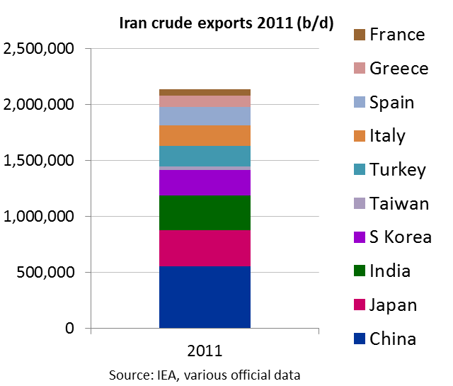
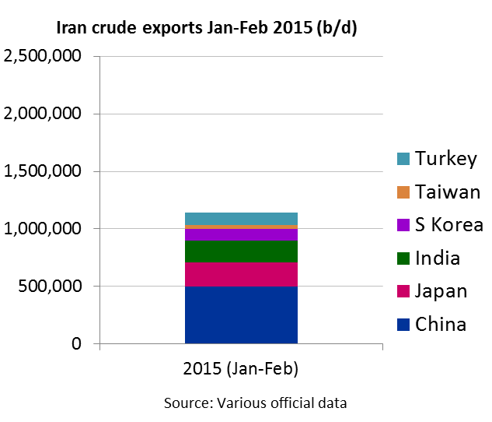
Iran readies to unleash more barrels
Looking to raise output to 4 mil b/d from current 2.85 mil b/d within a year of sanctions being lifted
“...Some countries take other members’ shares and if others want to come back to the market, they must fight...not a problem. We fight and won't let go of one barrel of our previous share.“ – Bijan Zanganeh, March 2015

Slide 18
1.9 million b/d of Europe refinery closures
Year | Refinery | Output (b/d) | Owner | Status
2009 | Dunkirk, France | 140,000 | Total | Permanent
 | Wilhelmshaven, Germany | 260,000 | Hestya Energy | Permanent
 | Teesside, UK | 117,000 | Petroplus | Permanent
2010 | Reichstett, France | 85,000 | Petroplus | Permanent
2011 | Cremona, Italy | 90,000 | Tamoil | Permanent
2012 | Rome, Italy | 86,000 | TotalERG | Permanent
 | Petit Couronne, France | 162,000 | Petroplus | Permanent
 | Berre l'Etang, France | 105,000 | LyondellBasel | Indefinite
 | Coryton, UK | 220,000 | Petroplus | Permanent
 | Arpechim, Romania | 70,000 | Petrom | Permanent
 | Paramo, Czech Republic | 20,000 | Unipetrol | Permanent
 | Lisichansk, Ukraine | 160,000 | Rosneft | Indefinite
2013 | Porto Marghera, Italy | 80,000 | Eni | Permanent
 | Tenerife, Canary Islands | 87,000 | Cepsa | Indefinite
 | Harburg, Germany | 110,000 | Shell | Permanent
2014 | Odessa, Ukraine | 56,000 | Vetek | Indefinite
 | Mantova, Italy | 55,000 | MOL | Permanent
Source: Platts, Company Data

Slide 19
More European refineries at risk
Grangemouth
Lietuva
Fredericia
Stanlow
Lindsey
Whitegate
Milford
Q8 Europoort
Kralupy
Donges
Collombey
Sisak
Petrotel
Livorno
Falconara
La Mede
Taranto
Thessaloniki
Gela
Source: Market sources

Slide 20
Oil Price in Search of a New Normal?
Platts Dated Brent Assessment, $/b
Islamic State captures Baiji refinery Jun 24
?
OPEC retains 30 mil b/d target Nov 27
Saudi Arabia lowers Asia OSPs Oct 1
$50-70/b
Drop in US rig count accelerates end-Jan
$45-70/b?
Source: Platts Data

Slide 21
Supply and demand drivers
Supply
Demand
ISIL activity in Iraq and Syria
Libyan outages and civil war
Strife in Yemen, Sudan, Nigeria
Plummeting investment in Russian oil
Resurgent US gasoline demand
Asia, Middle East demand growth
Chinese strategic stockpiling?
Near-record low crude oil prices
US shale resilience amid price plunge
Lack of OPEC response
Iraq output high despite ISIL
1 mil b/d additional supply from Iran?
Economic woes in Brazil, Russia, China
Record high commercial stockpiles
Commodity-dependent economy demand

Slide 22
Joel Hanley
Editorial Director, Oil
joel.hanley@platts.com
+44 (0)20 7176 6142

