Slide 1
Use of blockchain in gas trading / Использование технологий блокчейна в газовом трейдинге
Oil & Gas forum, 20th of September 2018
Национальный нефтегазовый форум, 20 сентября 2018

Slide 2
We are Uniper
Uniper is an international energy company with approximately 12,000 employees and operations in more than 40 countries.
Our portfolio comprises industrial-scale plants, trading activities and service provision.
We stand for a reliable supply of energy.
Since September 2016, Uniper has been listed on the stock exchange and represented in the MDAX and MSCI-Germany.
Employees¹
Share price development
€
1 As of YE 2017

Slide 3
Uniper – At a glance
European Generation
One of the largest European generators with 26 GW of own, mostly dispatchable generation capacity
Diversified base across technologies and markets
Strong capabilities in construction, operations and maintenance
Global
Commodities
Leading physical energy trader, global footprint
Large gas midstream business in Europe with more than 400 TWh gas LTC portfolio, own storage capacity of 8.2 bcm and pipeline shareholdings
Optimization of European Generation portfolio
Split¹
International Power
Primarily power business in Russia
Unipro as number 3 privately-owned Russian generation company
11 GW of generation assets
Capital Markets Story, Aug - Oct 2018

Slide 4
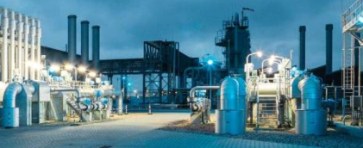
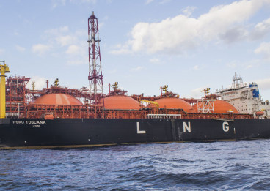
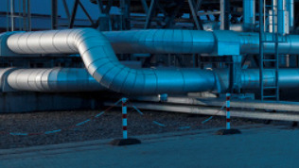
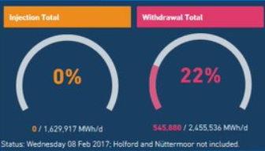
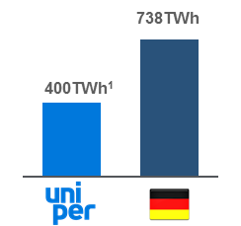
Global Commodities – Strong asset base along the entire gas value chain
Global Commodities: Gas value chain
Procurement of in total ~1,700 TWh from domestic and foreign producers
Thereof ~400 TWh contracted long-term with time and volume flex
Market-reflective pricing
Shareholdings in OLT Regasification terminal with regulated earnings
LNG bookings in Gate and Grain and access to terminals in Spain with the ability to bring additional volumes into the market
Shareholdings in major European transit pipelines
Bookings across Europe:
Hub-to-hub
Market entry-exit
Storage entry-exit
#3 storage player in Europe with a flexible, diversified storage portfolio
8.2 bcm of storage capacity
Gas Sales of in total ~1,700 TWh, thereof around 20%² con-tracted to traditional sales customers with specific demand patterns
>1,000 customers, mainly municipal utilities, industrials and power plants
Gas, power, energy related services
Market share ~40%
Supply Portfolio
Infrastructure shareholdings and bookings
Sales Portfolio
LNG Regas
Transmission
Storage
Uniper Market Share
~30%
21%
3%
25 bcm
985 TWh
~400 TWh¹
Nord Stream II
Market Capacity
8bcm
BBL
OPAL
5bcm
Transitgas
OLT
2016
1. Reflecting annual contracted quantity (ACQ) and not minimum offtake obligation.
2. Volume depending on gas to power demand and temperatures.
Capital Markets Story, Aug - Oct 2018

Slide 5
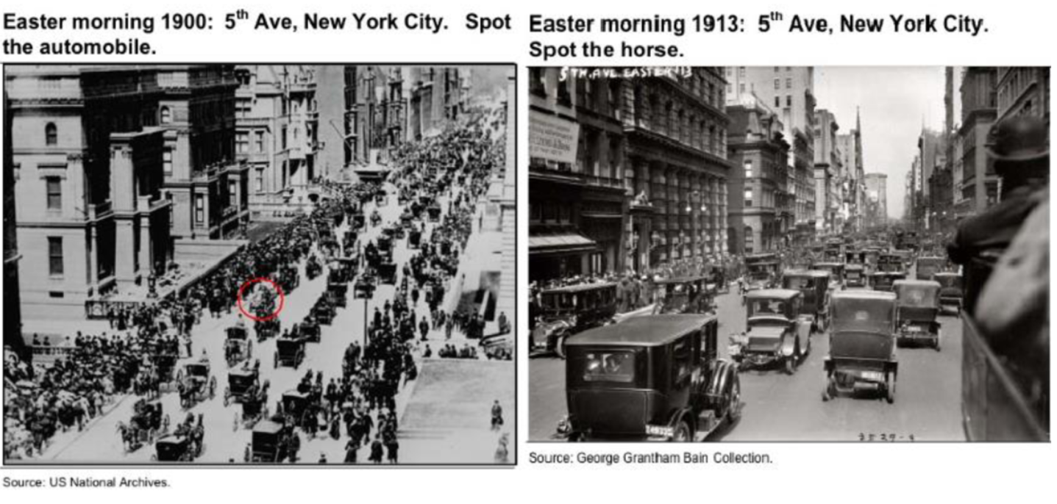
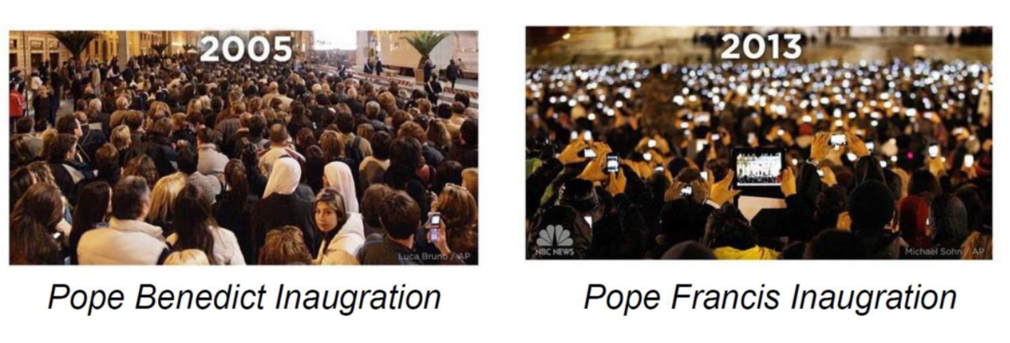
Changing world
Growth of automobile industry in early 20th century
Spread of smartphones in early 21th century
Sources: Uniper Global Commodities, US National Archives, George Grantham Bain Collection

Slide 6
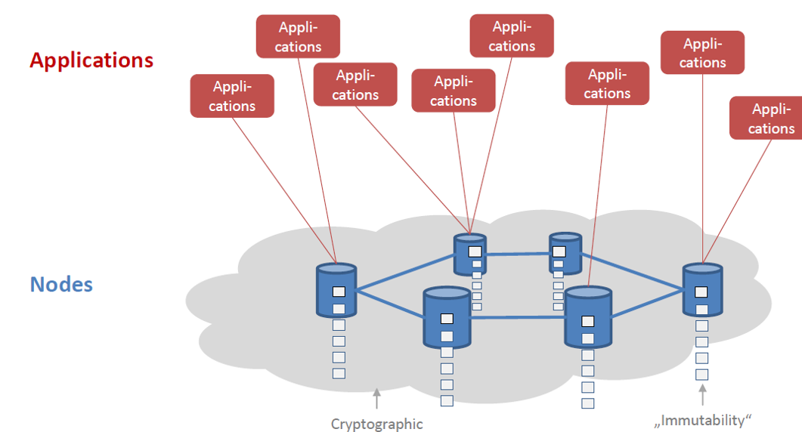
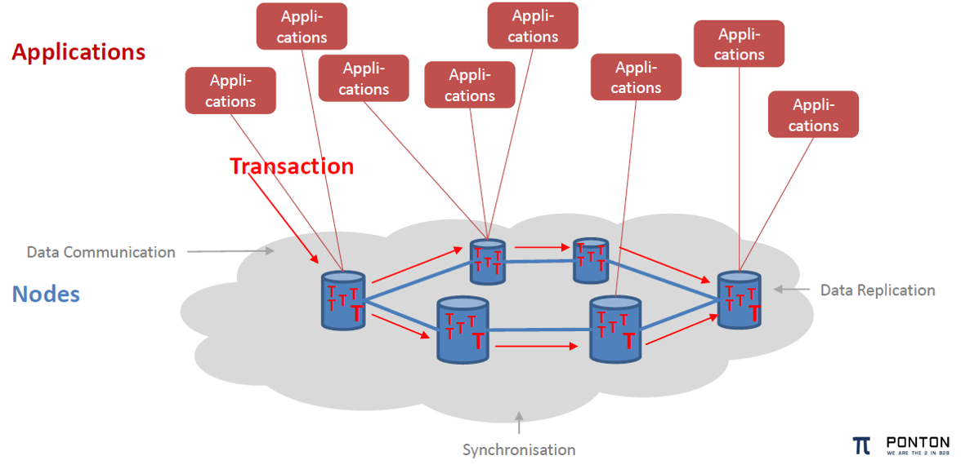
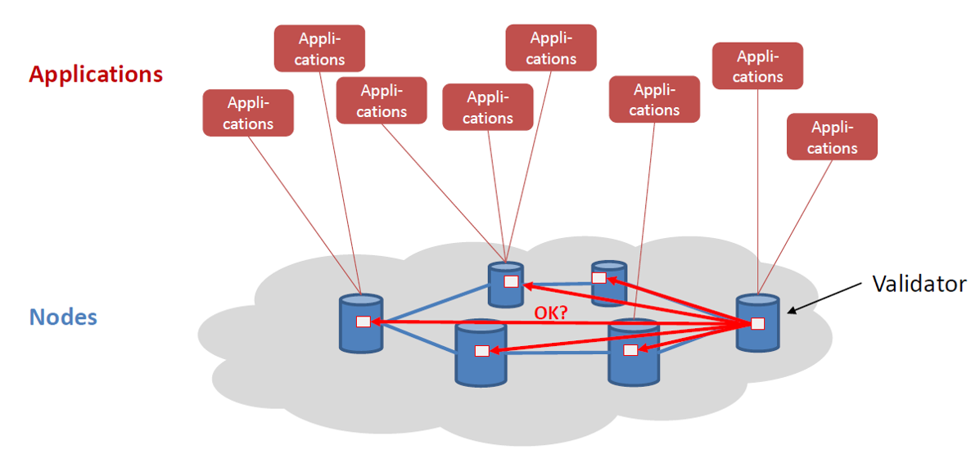
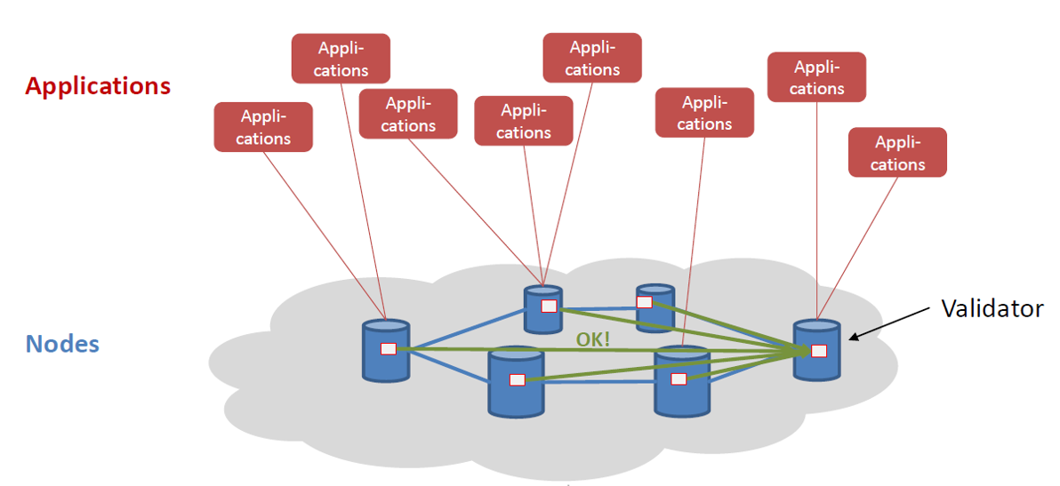
Data exchange over the blockchain
Applications and nodes are key for transaction and storing communication history
Blockchain is a distributed, digital transaction technology that allows for securely storing data and executing smart contracts in peer-to-peer networks
contains a continuously growing list of data records, the so-called blocks: • time-stamped • shared • unalterable • connected to preceding blocks;
blocks contain data and programs, batches of individual transactions, and executables
transactions are verified by computers run by the network’s users, the so-called nodes, in short intervals; they are distributed, public, and encrypted
A transaction platform based on Blockchain may be set up as a private network with authorized access, for example as an internal strategy of a bank to reduce transaction costs, or as a public network with open access
1
2
3
4
Successful validation is needed for execution of a transaction
Source: Ponton, Uniper Global Commodities

Slide 7
Cost drivers differ along the trade lifecycle
Trade execution
Confirmation
Invoicing & Settlement
Deal Capture
Dispatching
deal execution
post-deal execution
Cost Driver: Fees
Blockchain opportunity:
Disintermediation to reduce the fees
Cost Driver:
Double booking & reconciliation
Blockchain opportunity:
Use shared data to minimize reconciliation and prevent double booking
Sources: Uniper Global Commodities

Slide 8
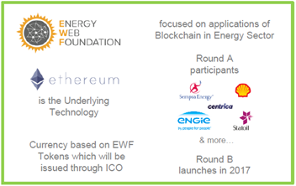
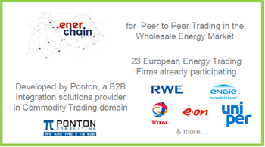
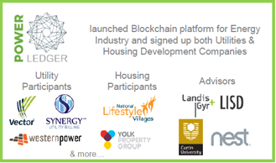
Blockchains in the Energy Sector
Plattforms
Use Cases
Trading Platforms
P2P Trading
Decentralized Generation
Processes
Grid
Mgmt
Sales &
Marketing
Mobility
Automation
Commu-
nication
Security
Billing
Metering
& Data
Transfer
Sources: ESMT Berlin, Dena German Energy Agency, Uniper Global Commodities

Slide 9
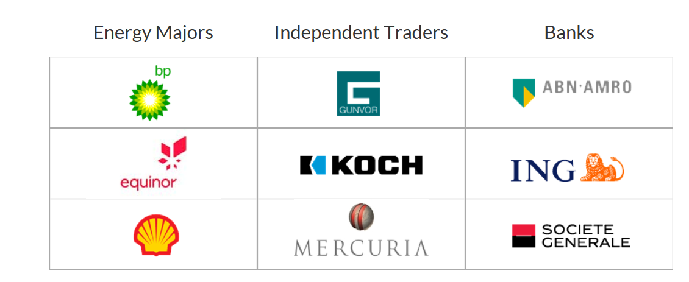
Platforms: use of blockchain in energy trading (1/2)
The VAKT platform is a digital ecosystem for physical post-trade processing
Using blockchain technologies, it will eliminate reconciliation and paper-based processes, enhance efficiency and create new trade finance opportunities ​
Technology to solve a business problem NOT a technology one - only in as much as it served the business problem
VAKT is driven by nine leading energy companies and banks who have chosen to use blockchain technology and develop an industry-wide solution to every day problems
Cyber Security
Efficiency
Trade Finance
secure platform. All trade data is fully encrypted
the only parties with access to the data are the counterparties themselves, and they will have an immutable ledger of their activity
counterparties have a single source of operational data, i.e. errors will be eliminated & greater visibility on logistics data, resulting in improved scheduling and decision making
digitalization of post trade processing to unlock up to 40% savings across operations, accounting, settlements & IT
partnering with banks to create a marketplace for trade finance, ensuring banks compete to provide cost-effective financing options
customers will be able to provide banks with direct visibility of relevant data for each trade
banks can optimize operations, i.e. lower premiums & faster settlements
Sources: Vakt

Slide 10
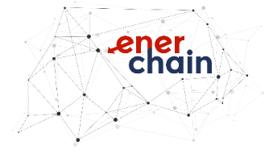
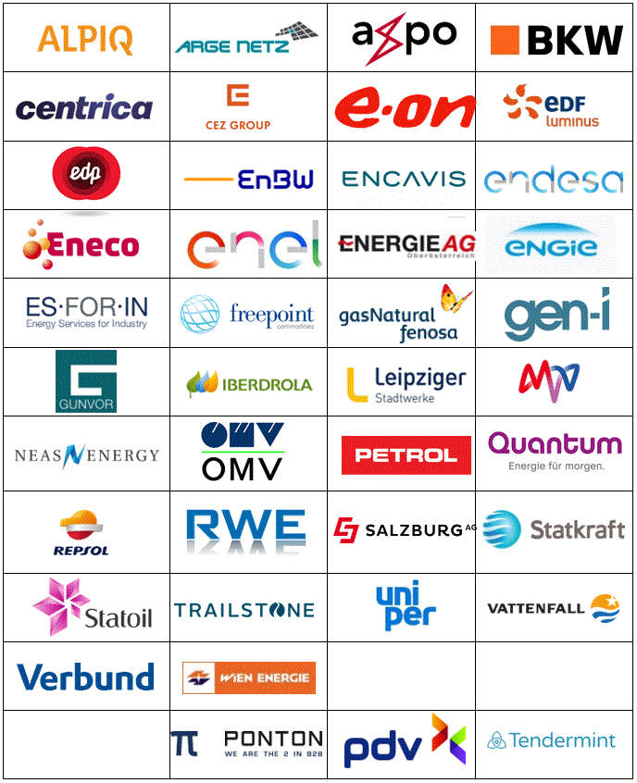
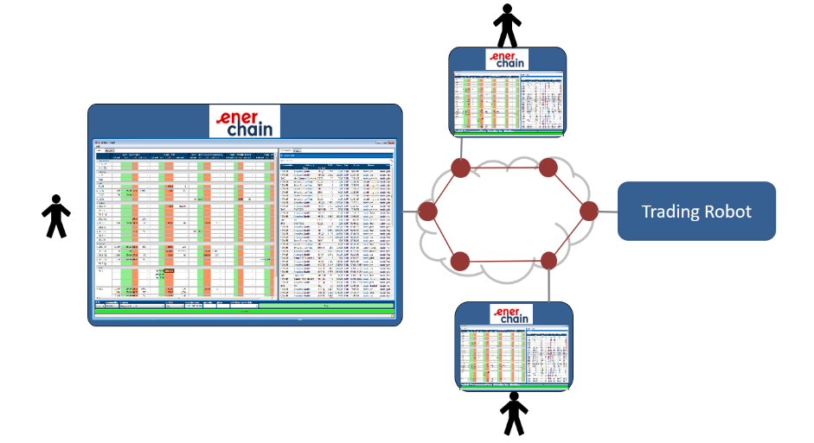
Platforms: use of blockchain in energy trading (2/2)
Enerchain: Europe‘s first energy trade over the blockchain of energy futures products
A consortium of several European energy trading companies testing the use of blockchain for peer to peer trading
Aim is to achieve more efficient operational processes and reduced transaction cost: no admission fees, no transaction fees, no clearing fees
October 2017 in Amsterdam: gas day-ahead deal with NCG delivery and day-ahead trade for power delivered to MAVIR (Hungary) shown live to public (over 100 participants)
Sources: Uniper Global Commodities, Enerchain.ponton.de

Slide 11
Commodity Trading Firms (CTFs) Perform Essential Economic Functions
CTFs add value by identifying and optimizing transformations in commodities that reconcile mismatches between supply and demand:
In space
through transportation of commodities from regions where they are produced to places they are consumed
through storage that bridges the timing between consumption and production
In form
In time
through refining or processing for final consumption
Right product in the right place at the right time and at the lowest cost
Sources: Uniper Global Commodities

Slide 12
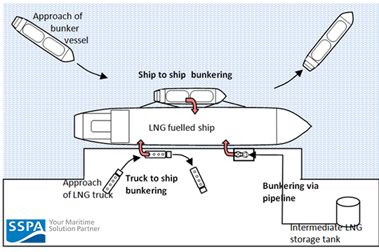
Business case “small scale LNG”: a growing market
Examples for use of Small Scale LNG:
Natural Gas Vehicles
Bunkering
Off-Grid solutions
Injection in Transportation Network
Gas Production
LNG Carrier
Break bulk
Regasification plant
Distribution by Small Scale LNG Carrier
LNG Transport by Truck
LNG Powered Truck
Secondary Coast Depot
LNG Transport by Truck
Sources: Uniper Global Commodities, SSPA
LNG-powered ships bunkering
Isolated Areas Power Plant

Slide 13
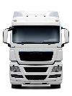
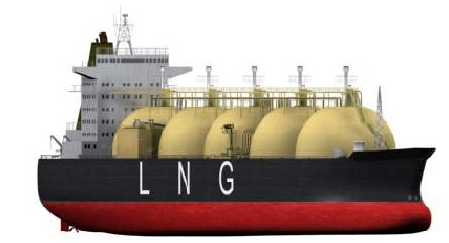
Business case “small scale LNG”: growth potential must be tackled by managing complexity
20 ship-to-ship bunkerings
750 truck-to-ship bunkerings
OR
20 industrial users p.a.
OR
30 LNG4trucks stations p.a.
OR
Assumptions: cargo size: 150k m3; STS: 7500 m3; TTS: 200 m3; ind. user consumption: 43 GWh/a; fuelling station consumption: 2 ktpa
Sources: Uniper Global Commodities

Slide 14
Processes: Shipping industry. Why blockchain?
90% of goods in global trade are carried by the ocean shipping industry each year.
(Source: IBM)
One Shipment can require sign-off from 30 unique organizations and up to 200 communications.
(Source: IBM)
Consensus 2017: Blockchain Could Save Shipping Industry ‘Billions’.
(Source: Coindesk)
With major portion of global trade carried across the oceans every day, managing and tracking the paper trail of millions of shipping containers can be a very cumbersome task. This can also lead to information gap among various stakeholders such as ship owners, suppliers / receivers, ports, shipping operators, etc.
Blockchain can be a solution to these challenges. It is a distributed database with ability to allow multiple parties to transfer and store sensitive data / information in a space called blocks that are secure, permanent, anonymous, and easily accessible.
With blockchain, based on permission status, each stockholder can have end-to-end visibility of shipping containers. Thus ensuring improved transparency and traceability, reduced fraud and errors and ultimately reduced cost and waste.

Slide 15
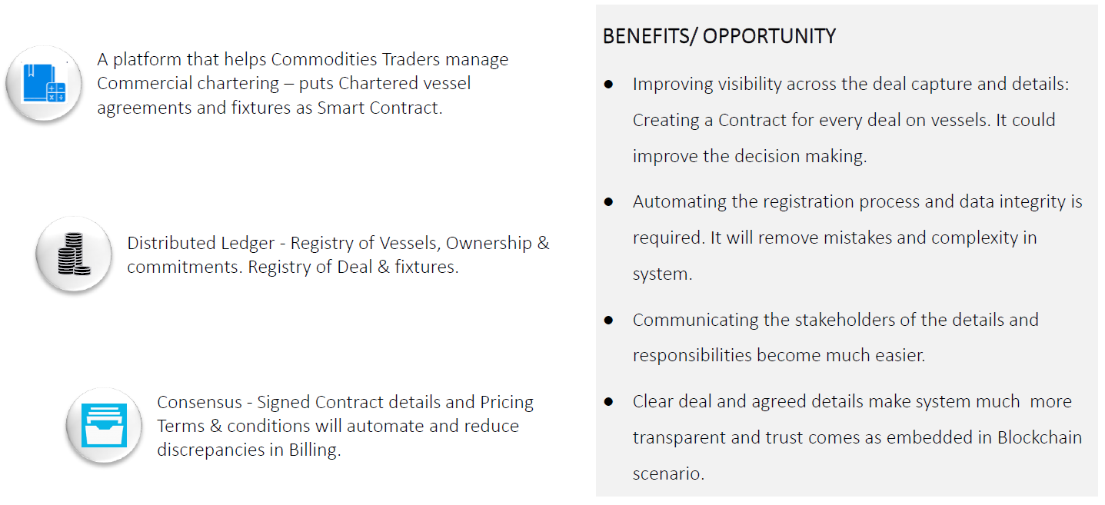
Processes: blockchain in deal management for use in shipping industry and small scale LNG

Slide 16
Thank you!
If you need any further information, please contact us:
Uniper SE
E.ON-Platz 1
40479 Düsseldorf
www.uniper.energy
Uniper disclaimer:
This presentation may contain forward-looking statements based on current assumptions and forecasts made by Uniper SE management and other information currently available to Uniper. Various known and unknown risks, uncertainties and other factors could lead to material differences between the actual future results, financial situation, development or performance of the company and the estimates given here. Uniper SE does not intend, and does not assume any liability whatsoever, to update these forward-looking statements or to conform them to future events or developments.

